Slide 1
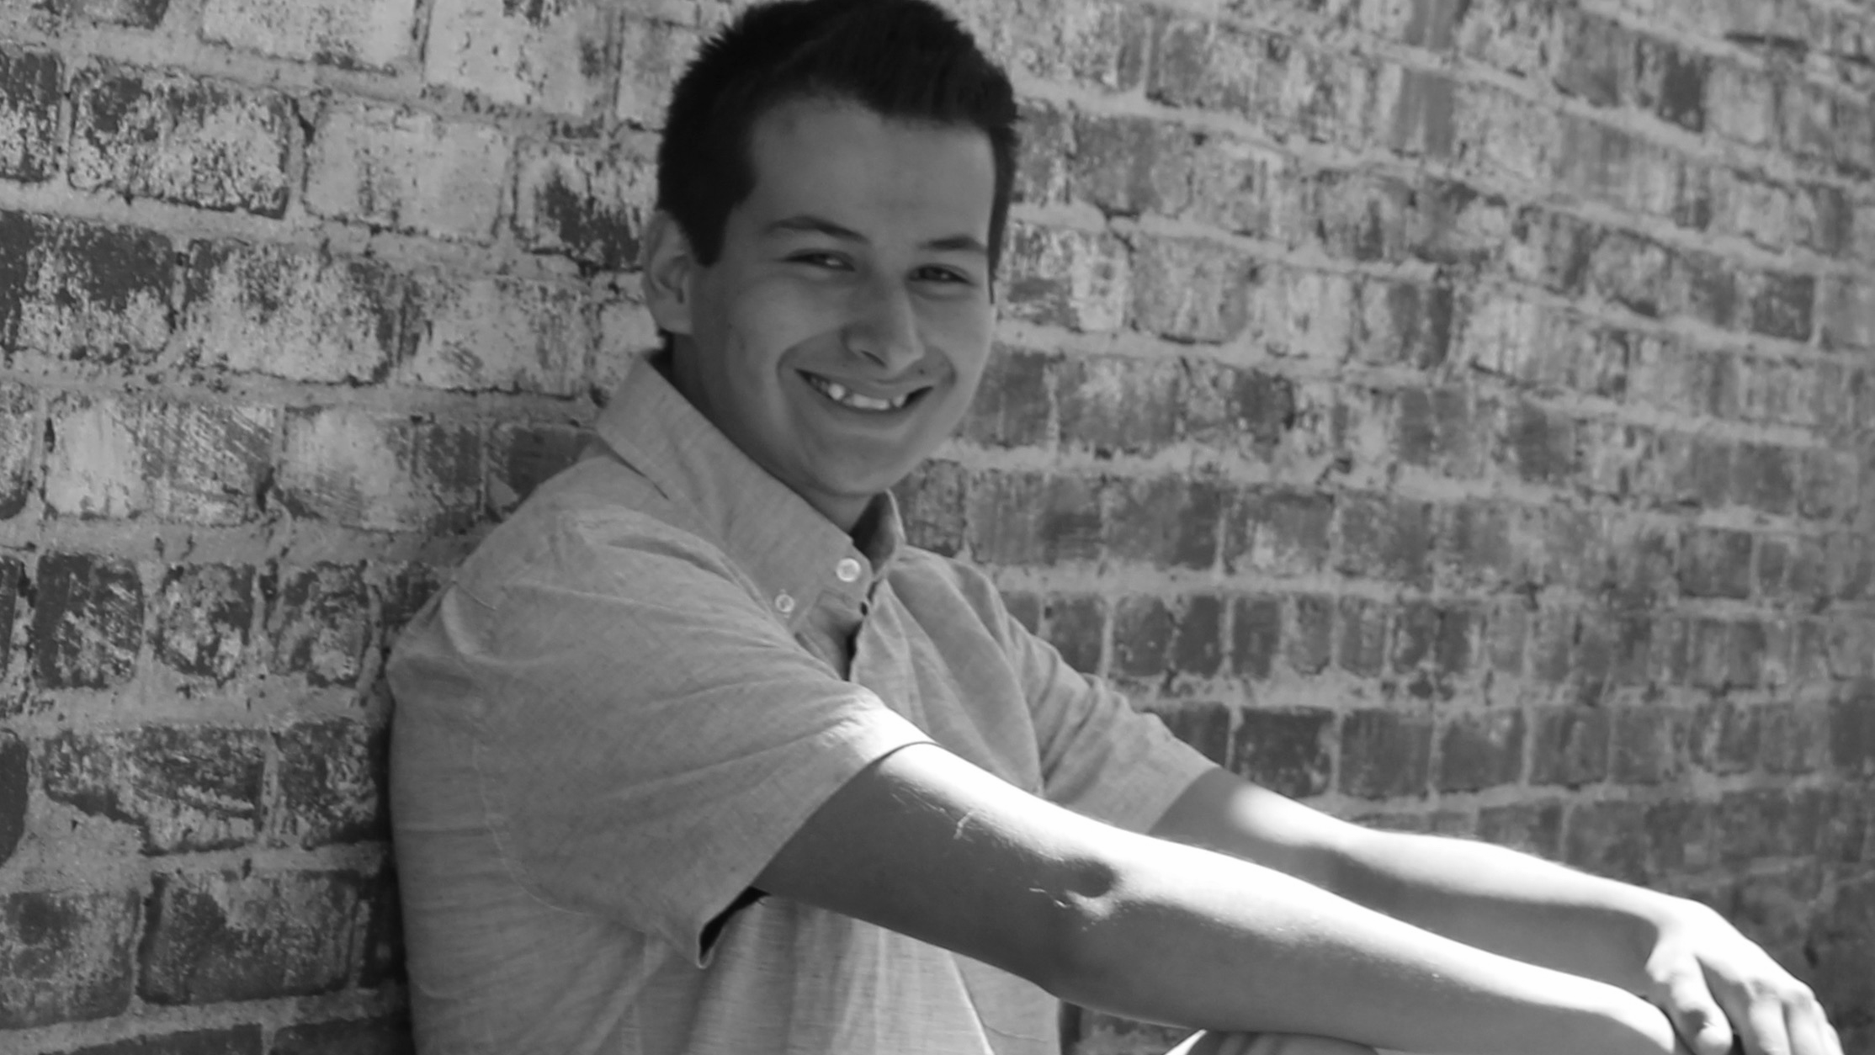
Rigoberto
Padilla
Class of 2017

Slide 2
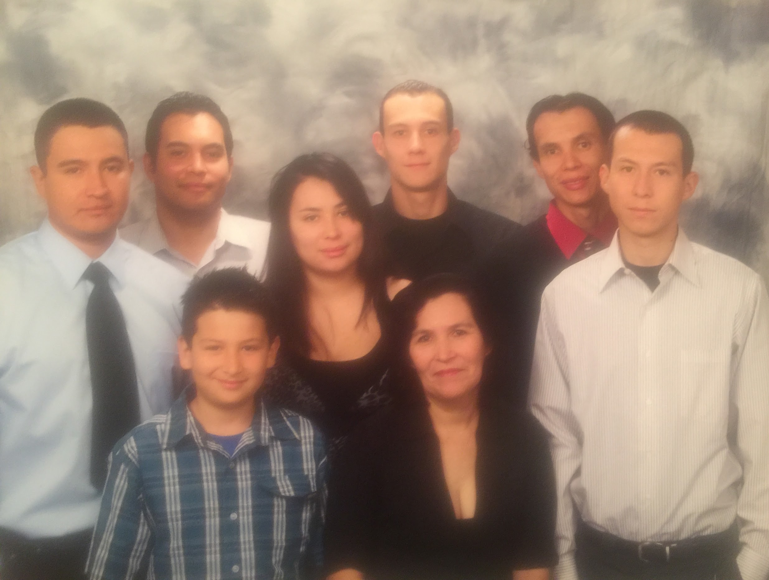
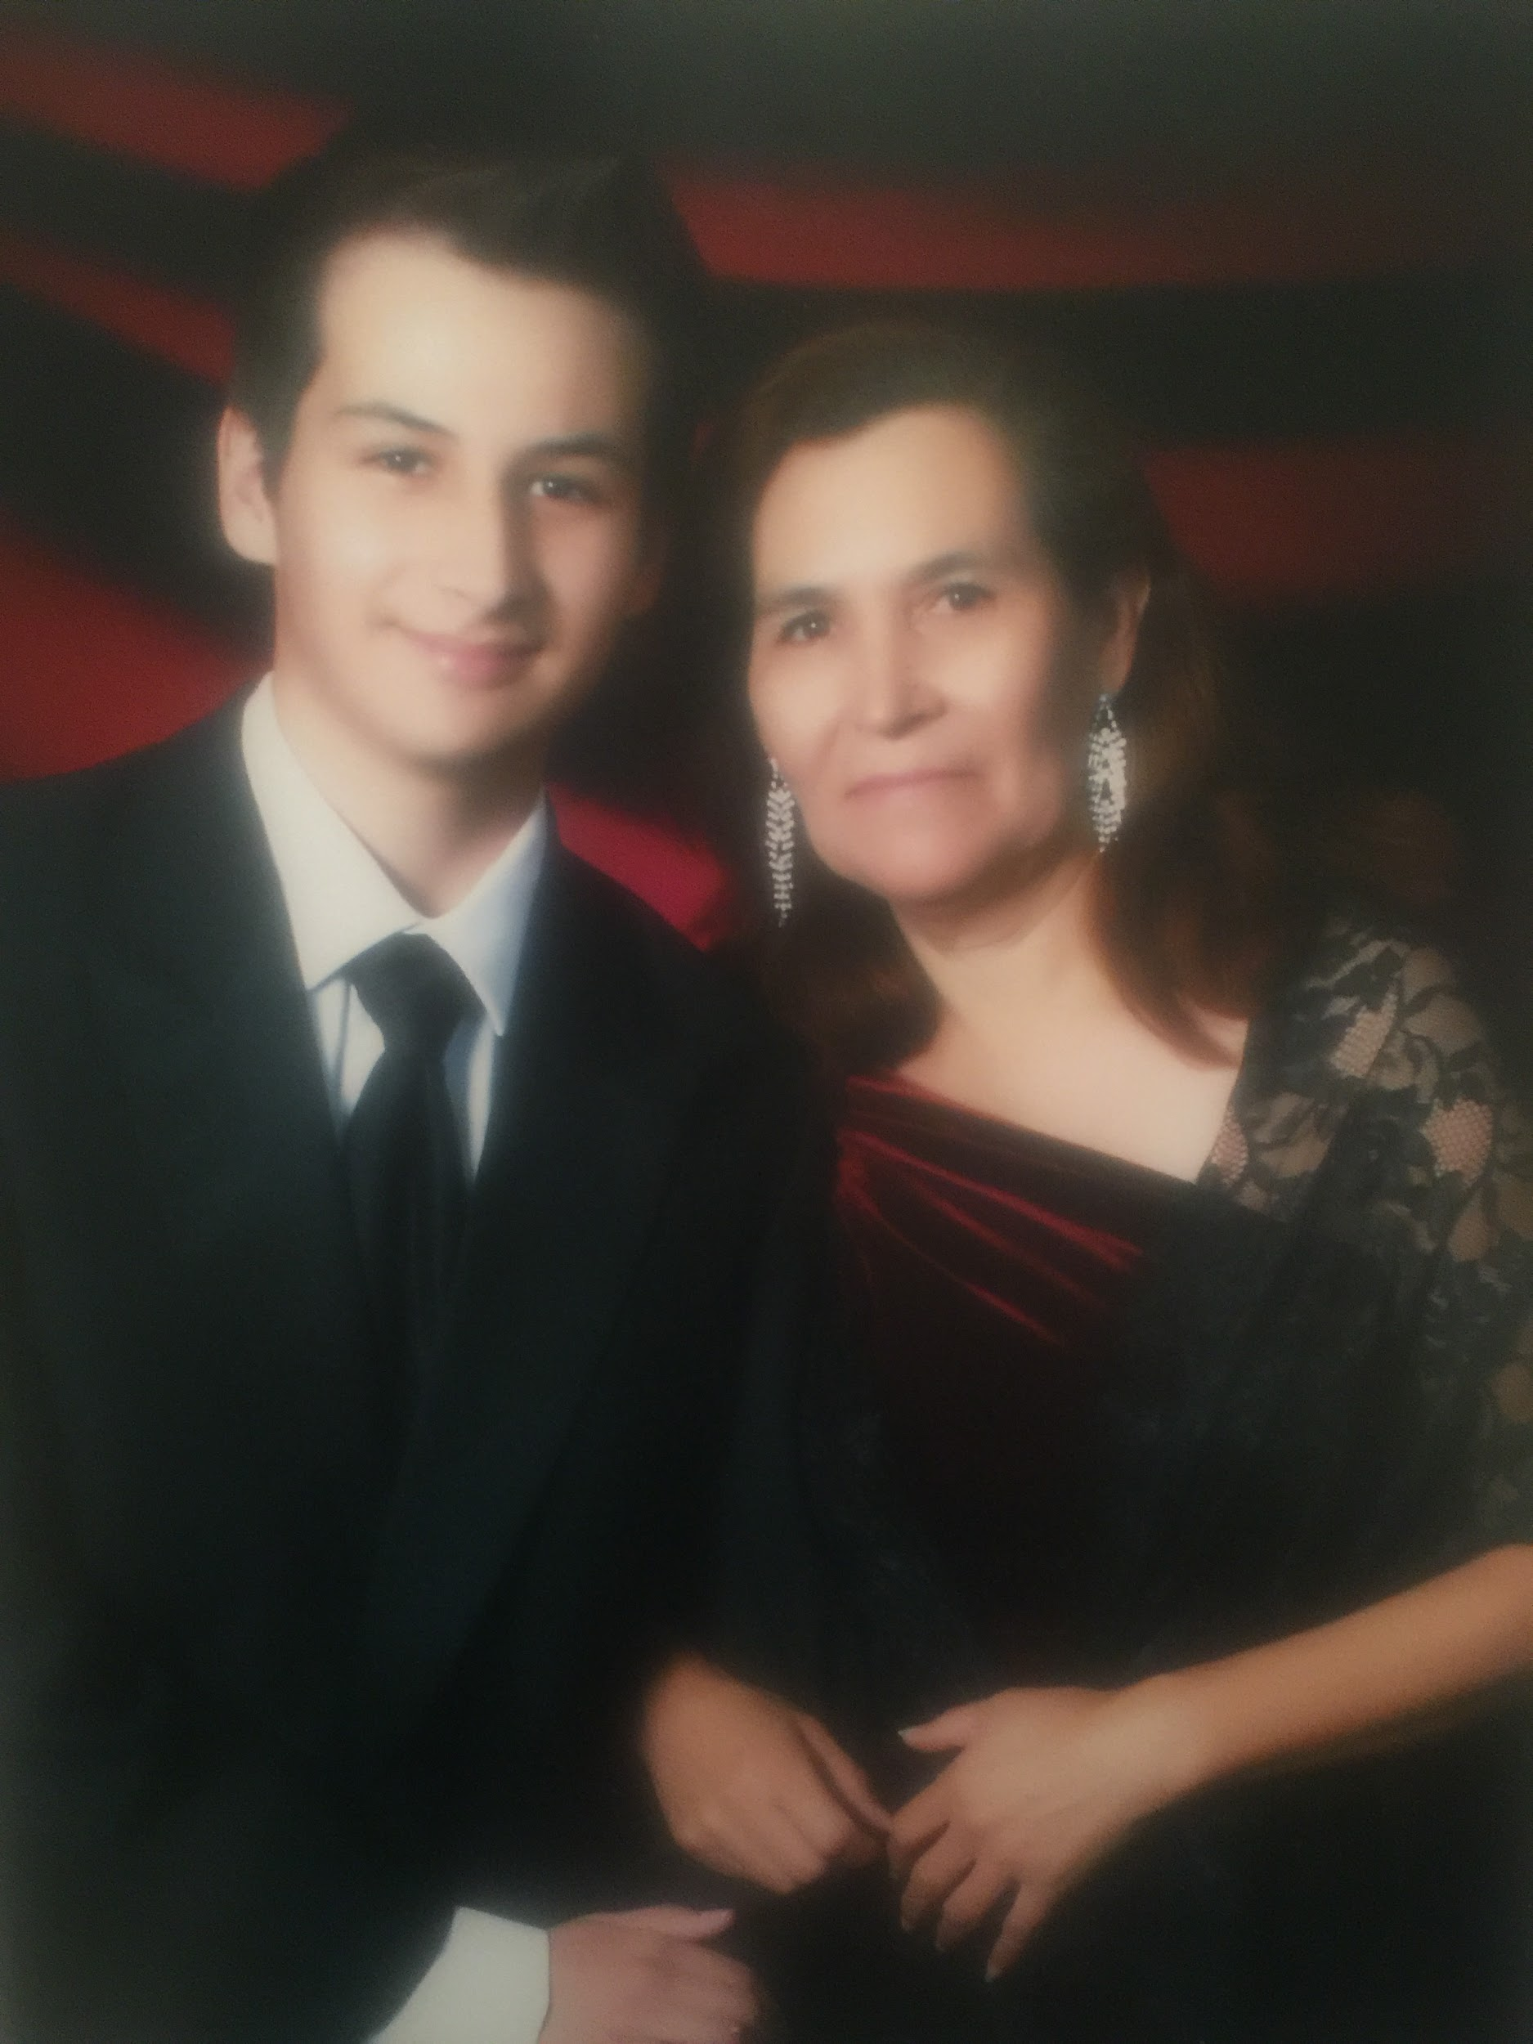
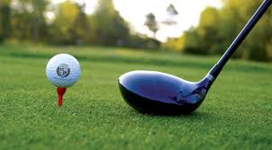
About Me
Come from a family of 7, single mother
Interests
Video games
Golf

Slide 3
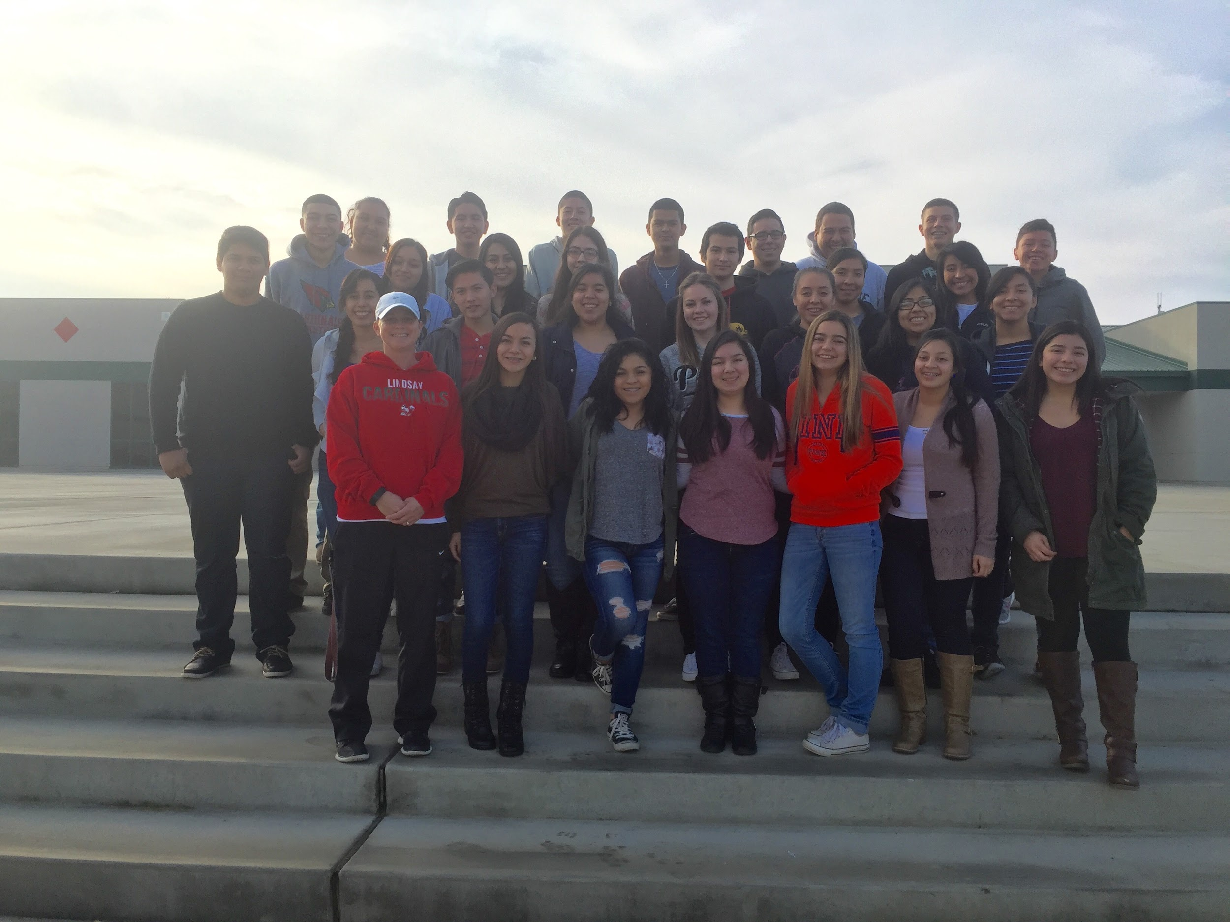
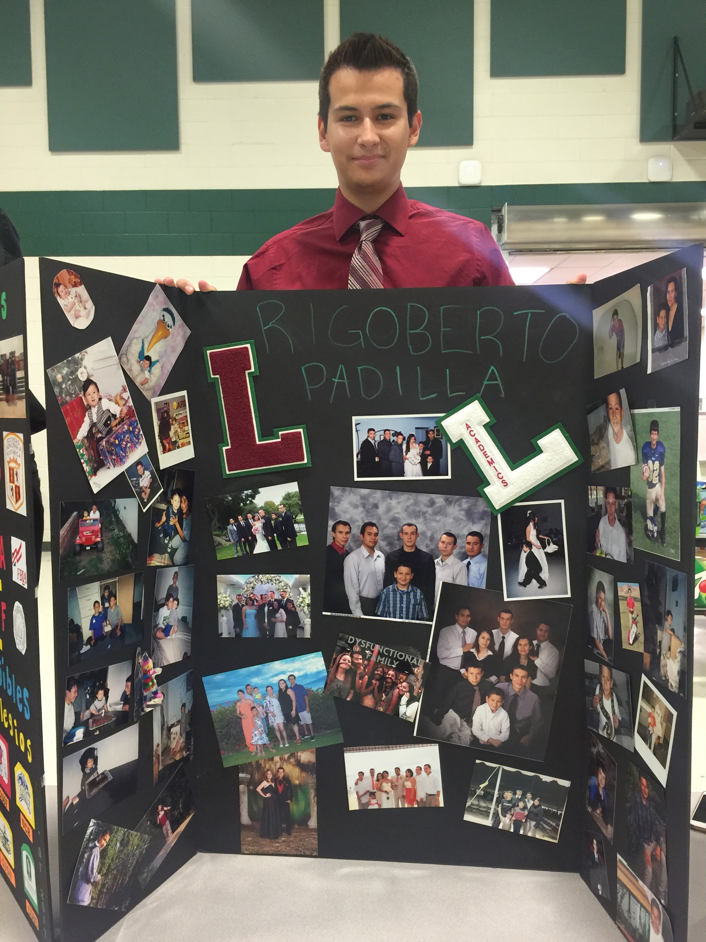
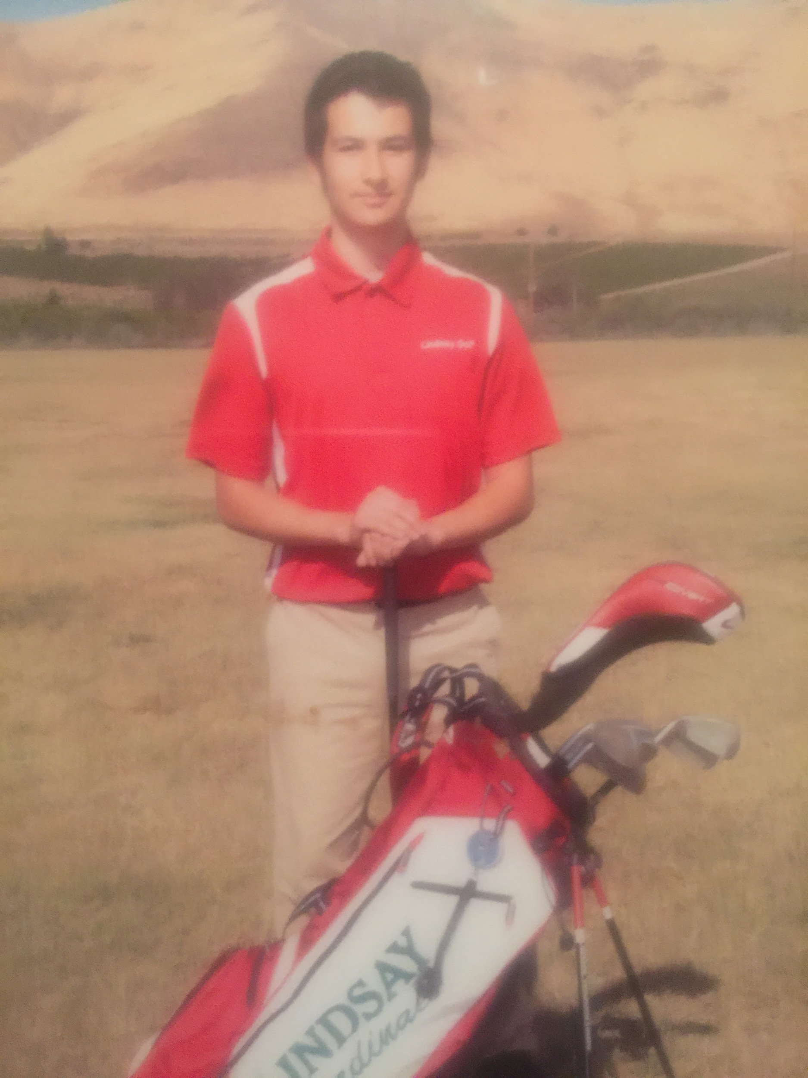
High School Experience
Extracurriculars
AVID
FBLA
Key Club
National Spanish Honors Society
Golf
Challenges:
Time Management
Relationship w/ my mom; I can do anything I set my mind to

Slide 4
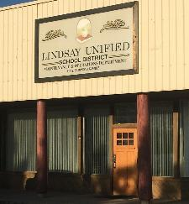
Job Shadow
Director of Lindsay Unified School District Facilities
Merced Doria
Supervises various work sites and projects

Slide 5
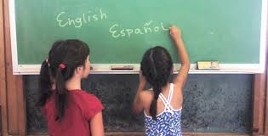
Pathway
Spanish
Bilingual
Taken advanced courses
Knowing two languages is vital

Slide 6
Post-High School Plans
Attend a 4-year university
CSU Long Beach, CSU Cal Poly Pomona, UC Riverside, CSU Fresno
Short term goal:
Accepted into college, good grades
Long term goals:
Major as an Electrical Engineer

Slide 7
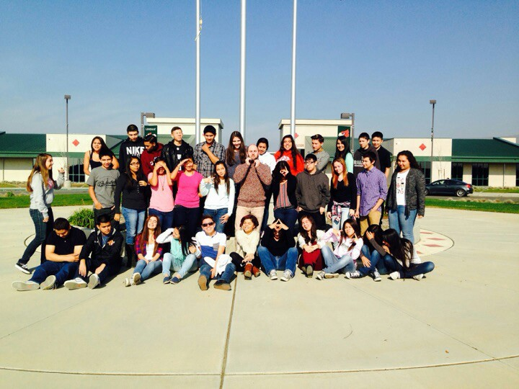
Leaving LHS
Influential Teachers
Mr. Guss
Performance Based System
Moved from a different school system
Accountability

Slide 8
Thank you,
Questions?

